Slide 1
Regularization
Sungjoon Choi
(sungjoon.choi@cpslab.snu.ac.kr)

Slide 2

Regularization?
Main purpose is to avoid “OverFitting”
http://www.freedomsquare.co.kr/2347#.VvELE-KLQuU

Slide 3
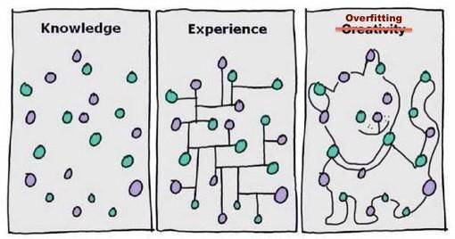
OverFitting?
This actually happens all the time!

Slide 4
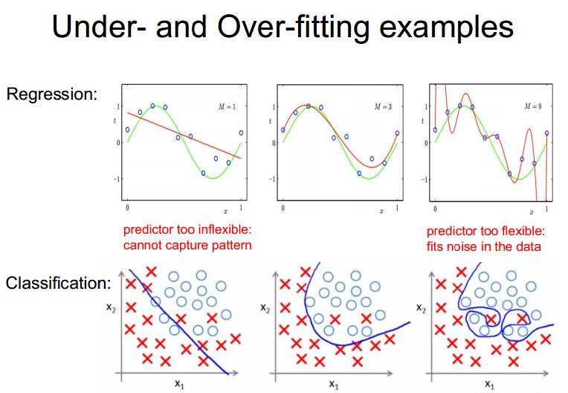
Examples

Slide 5
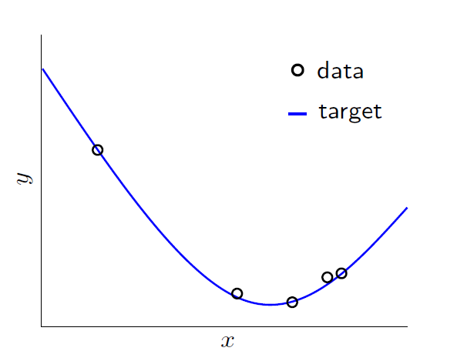
OverFitting
Literally, Fitting the data more than is warranted

Slide 6
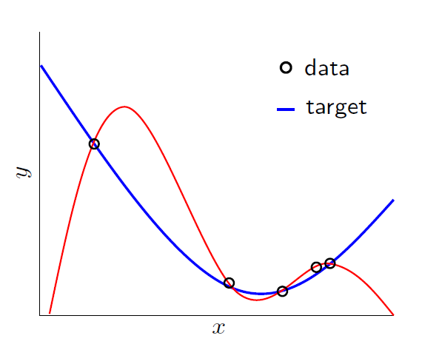
OverFitting
Literally, Fitting the data more than is warranted

Slide 7
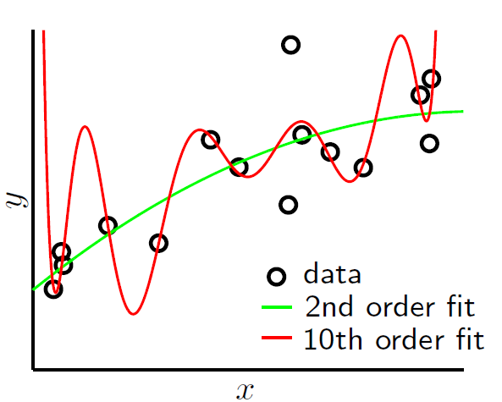
OverFitting
Things get worse with noise!

Slide 8
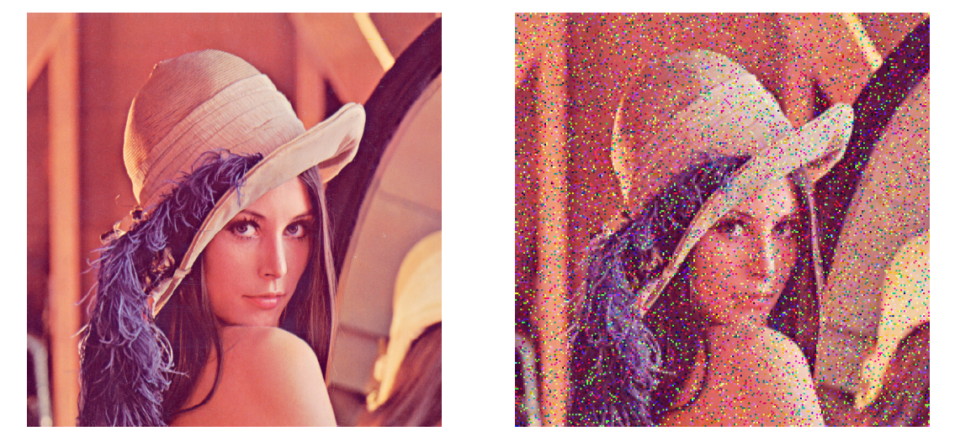
Stochastic Noise
Comes from random measurement error

Slide 9
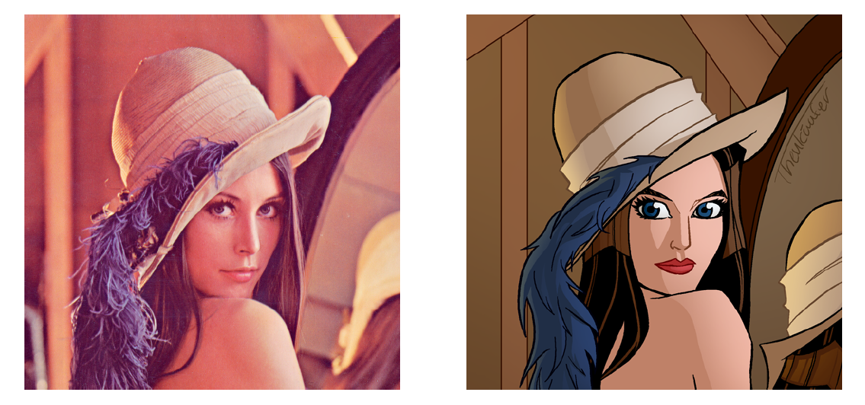
Deterministic Noise
Cannot model this type of error

Slide 10
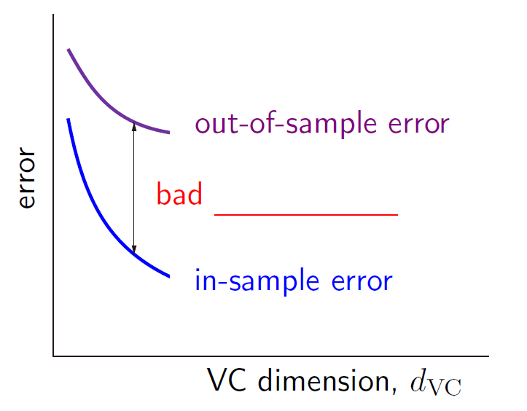
Mathematically,
Test error
Generalization performance
Training error
Complexity of the algorithm

Slide 11
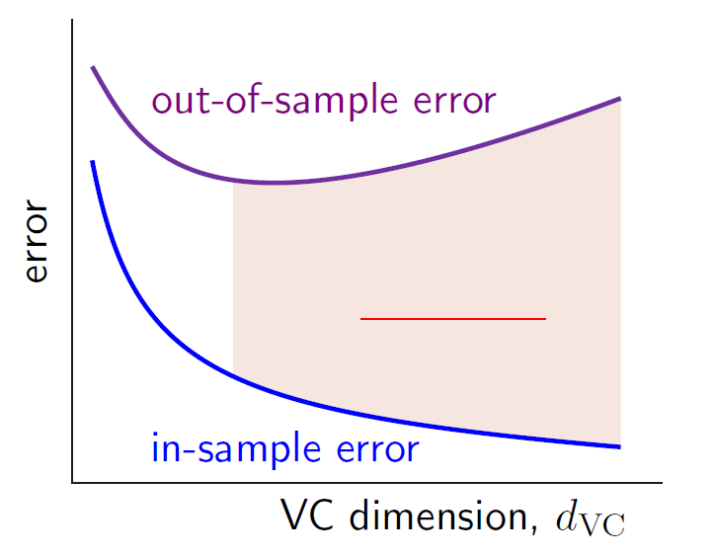
Mathematically,
Over fitting

Slide 12
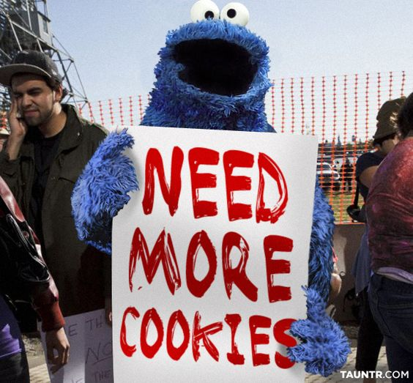

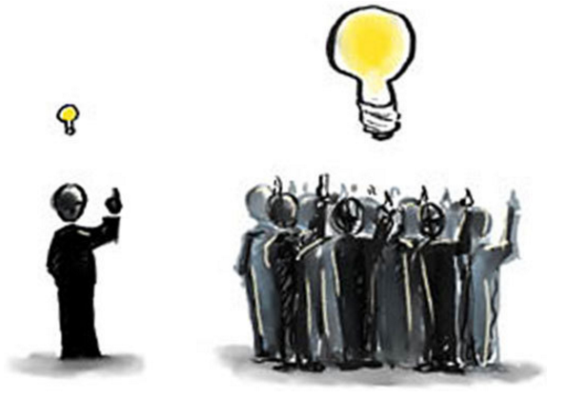
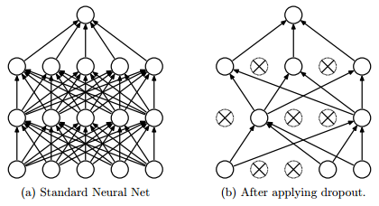
Preventing OverFitting?
Approach 1: Get more data
Approach 2: Use a model with the right capacity
Approach 3: Average many different models (Ensemble)
Approach 4: Use DropOut, DropConnect, or BatchNorm

Slide 13

Limiting the Capacity
Architecture: Limit the number of hidden layers and units per layer
Early stopping: Stop the learning before it overfits using validation sets
Weight-decay: Penalize large weights using penalties or constraints on their squared values (L2 penalty) or absolute values (L1 penalty)

Slide 14
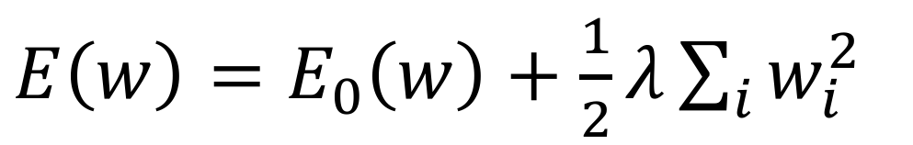
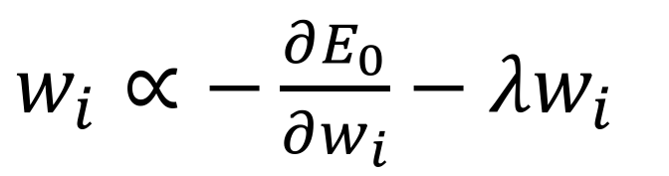
Weight Decay
$E\left(w\right)=E_{0}\left(w\right)+\frac{1}{2}λ\sum_{i}{w_{i}^{2}}$
$w_{i}∝−\frac{∂E_{0}}{∂w_{i}}−λw_{i}$
Anders Krogh and John A Hertz , "A simple weight decay can improve generalization." NIPS, 1995

Slide 15
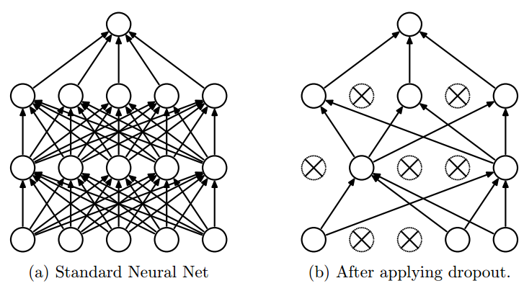
DropOut
DropOut increases the generalization performance of the neural network by restricting the model capacity!
Srivastava, Nitish, et al. "Dropout: A simple way to prevent neural networks from overfitting." The Journal of Machine Learning Research 15.1 (2014): 1929-1958.

Slide 16
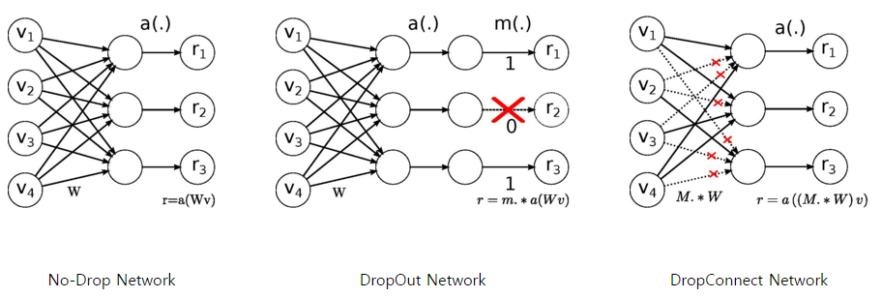
DropConnect
Instead of turning the neurons off (DropOut), DropConnect disconnects the connections between neurons.
Li Wan, Matthew Zeiler, Sixin Zhang, Yann LeCun, Rob Fergus "Regularization of neural networks using DropConnect.“ ICLML, 2013.

Slide 17
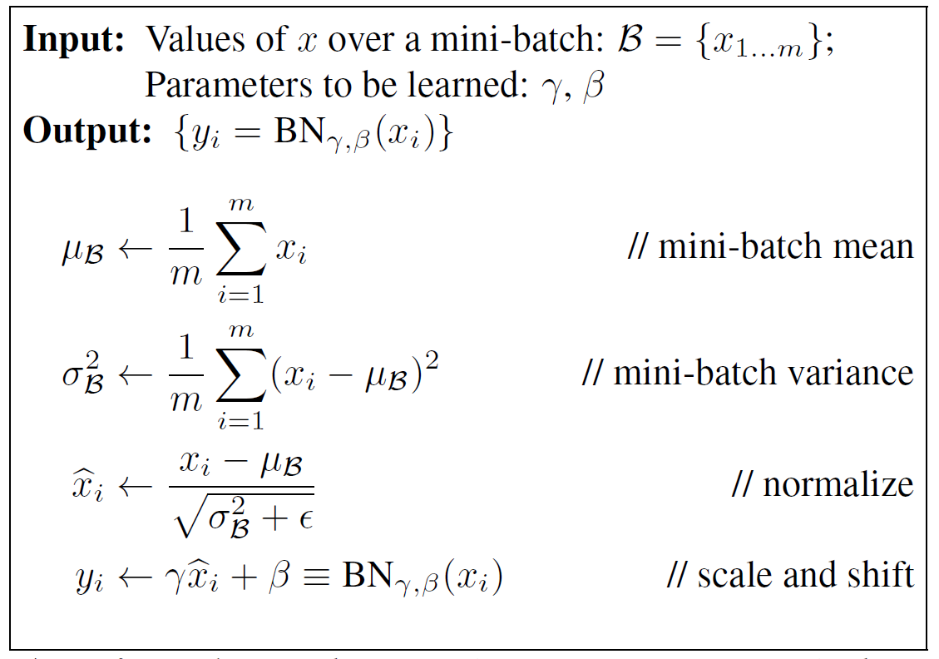
Batch Normalization
Benefits of BN
1. Increase learning rate
2. Remove Dropout
3. Reduce L2 weight decay
4. Accelerate learning rate decay
5. Remove Local Response Normalization

Slide 18

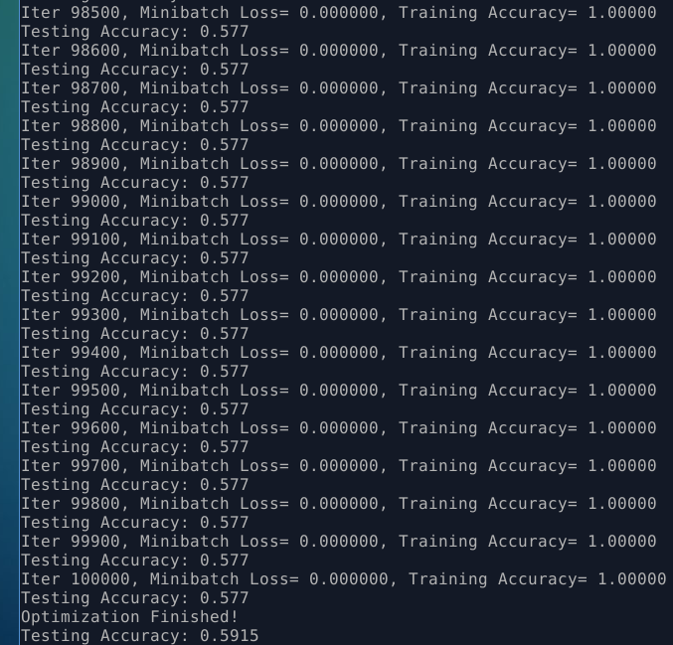
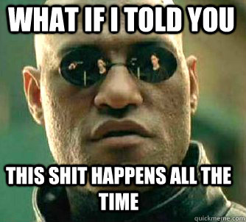
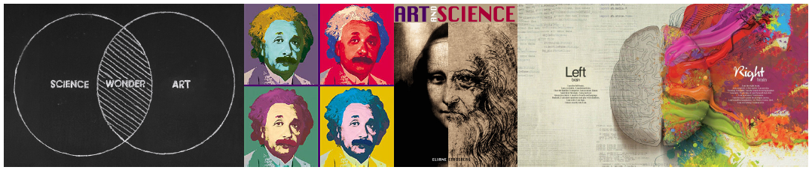
Conclusion

Slide 19
Book review
1. Parameter Norm Penalties
2. Dataset Augmentation
3. Noise Robustness: to input, weights, and output
4. Semi-Supervised Learning = learning a representation
5. Multitask learning
6. Early Stopping
7. Parameter Tying and Parameter Sharing
8. Sparse representation
9. Bagging and Other Ensemble Methods
10. Dropout
11. Adversarial Training

Slide 20
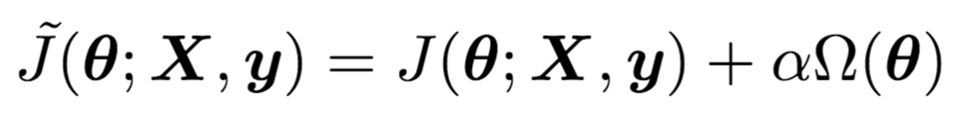
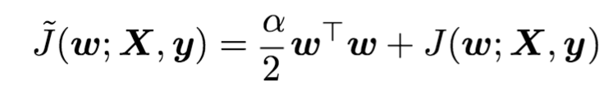
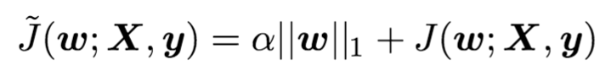
Parameter Norm Penalties
Many regularization approaches are based on limiting the capacity of models by adding a parameter norm penalty to the objective function.
L2 parameter regularization:
L1 parameter regularization:

Slide 21
Dataset Augmentation
The best way to make a machine learning model generalize better is to train it on more data.
Of course, in practice, the amount of data we have is limited. One way to get around this problem is to create fake data and add it to the training set.
Label preserving transformation is used.
Injecting noise in the input to a neural network can also be seen as a form of data augmentation.
Often, hand-designed dataset augmentation schemes can dramatically reduce the generalization error of a machine learning technique.

Slide 22
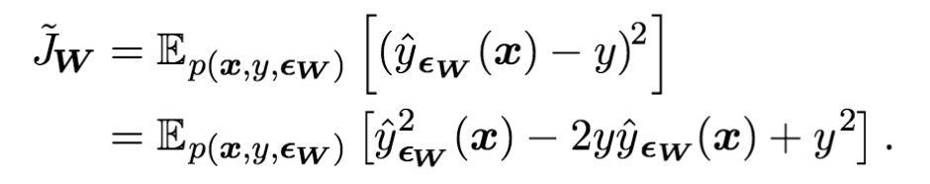
Noise Robustness
In the general case, it is important to remember that noise injection can be much more powerful than simply shrinking the parameters, especially when the noise is added to the hidden units.
Another way that noise has been used is by adding it to the weights.
Most datasets have some amount of mistakes in the y labels. Label-smoothing can be used in this regard.

Slide 23
Semi-Supervised Learning
In the paradigm of semi-supervised learning, both unlabeled examples and labeled examples are used to.
In the context of deep learning, semi-supervised learning usually refers to learning a representation.
The goal is to learn a representation so that examples from the same class have similar representations.
Unsupervised learning can provide useful cues for how to group examples in representation space.

Slide 24
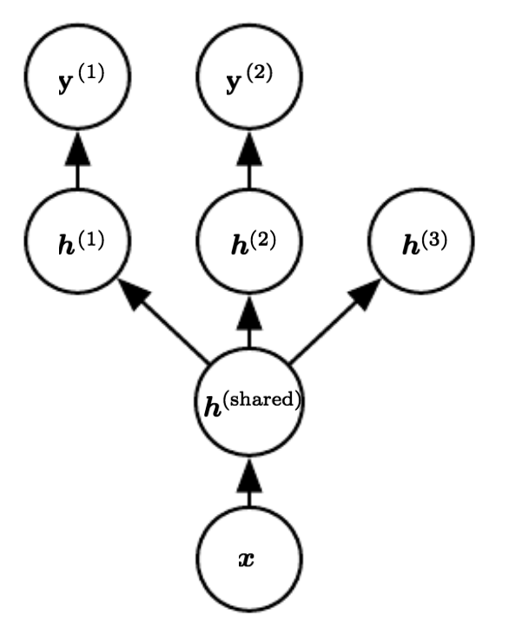
Multi-Task Learning
Multi-task learning is a way to improve generalization by pooling the examples arising out of several tasks.
Learning shared representation is a key point in multi-task learning.
From the point of view of deep learning, the underlying prior belief is the following:
“Among the factors that explain the variations observed in the data associated with the different tasks, some are shared across two or more tasks.”

Slide 25
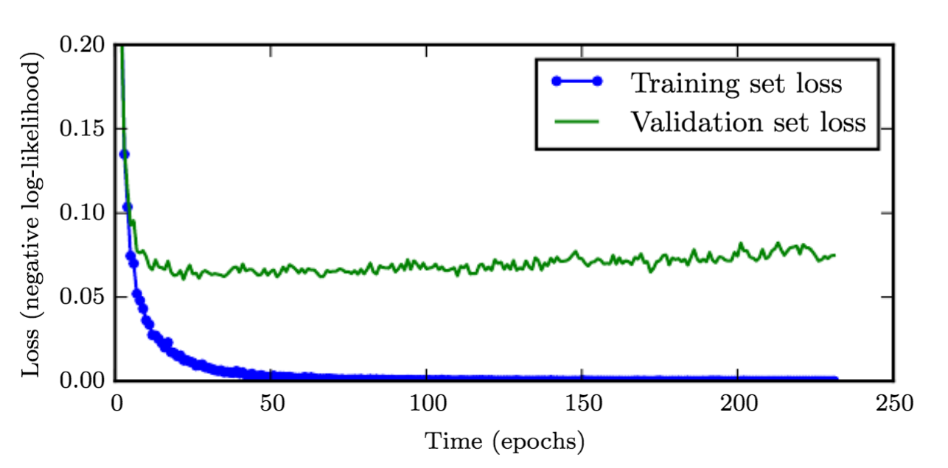
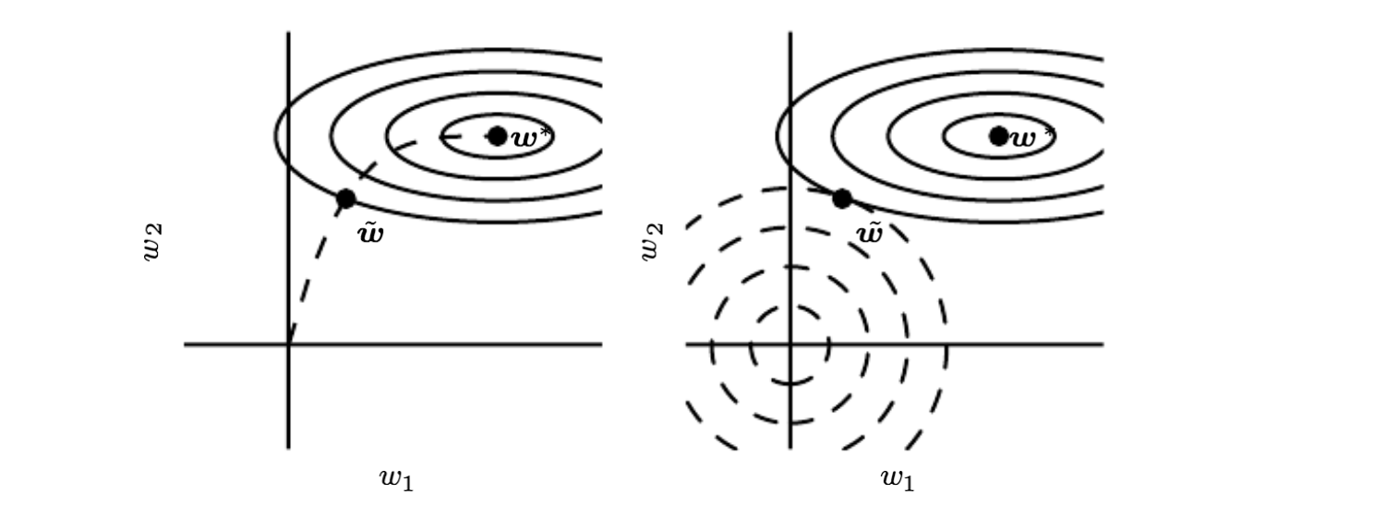
Early Stoping
When training large models with suﬃcient representational capacity to overﬁt the task, we often observe that training error decreases steadily over time, but validation set error begins to rise again.
Early stopping acts as a regularizer:

Slide 26
Parameter Tying and Parameter Sharing
A common type of dependency that we often want to express is that certain parameters should be close to one another.
Parameter Tying
Consider the following scenario: we have two models performing the same classification task (with the same set of classes) but with different input distributions.
Parameter Sharing
By far the most popular and extensive used of parameter sharing occurs in convolutional neural networks (CNNs).

Slide 27
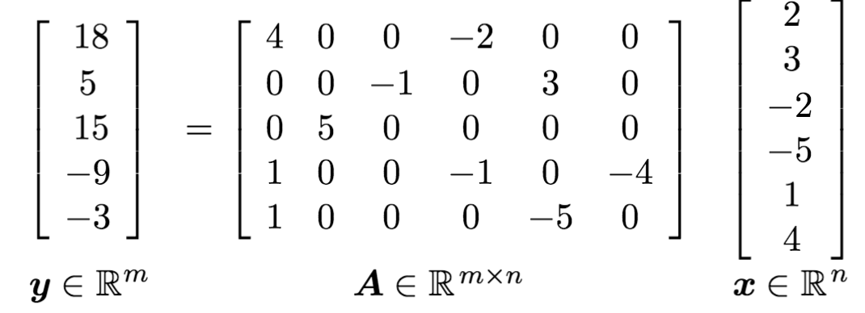
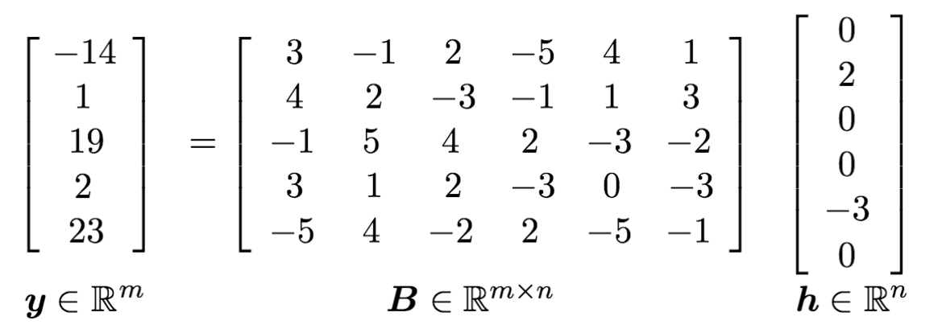
Sparse Representations
Representational sparsity describes a representation where many of elements are zero.
Sparse weights (L1 decay):
Sparse activations
Norm penalty regularization of representations is performed by adding to the loss function a norm penalty on the representations.

Slide 28
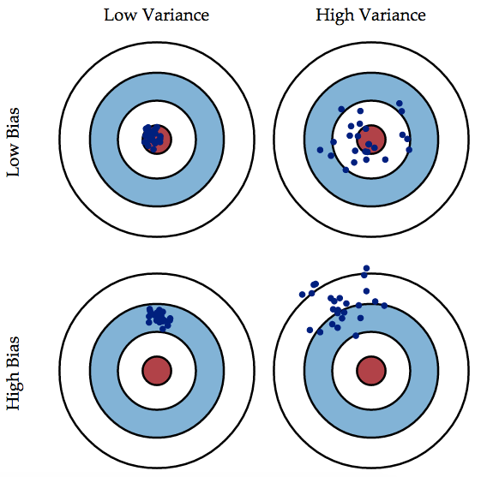
Bagging and Other Ensemble Methods
Bagging
Generate multiple sets of training data (with bootstrapping), multiple predictions and combine them with averaging prediction
Reduce overall variance using multiple low-bias models
Example: Random Forest
Bagging
Boosting
Boosting
Generate multiple weak learners and combine them to make a strong learner
Reduce overall bias using multiple weak learners
Example: Boosting, AdaBoost

Slide 29
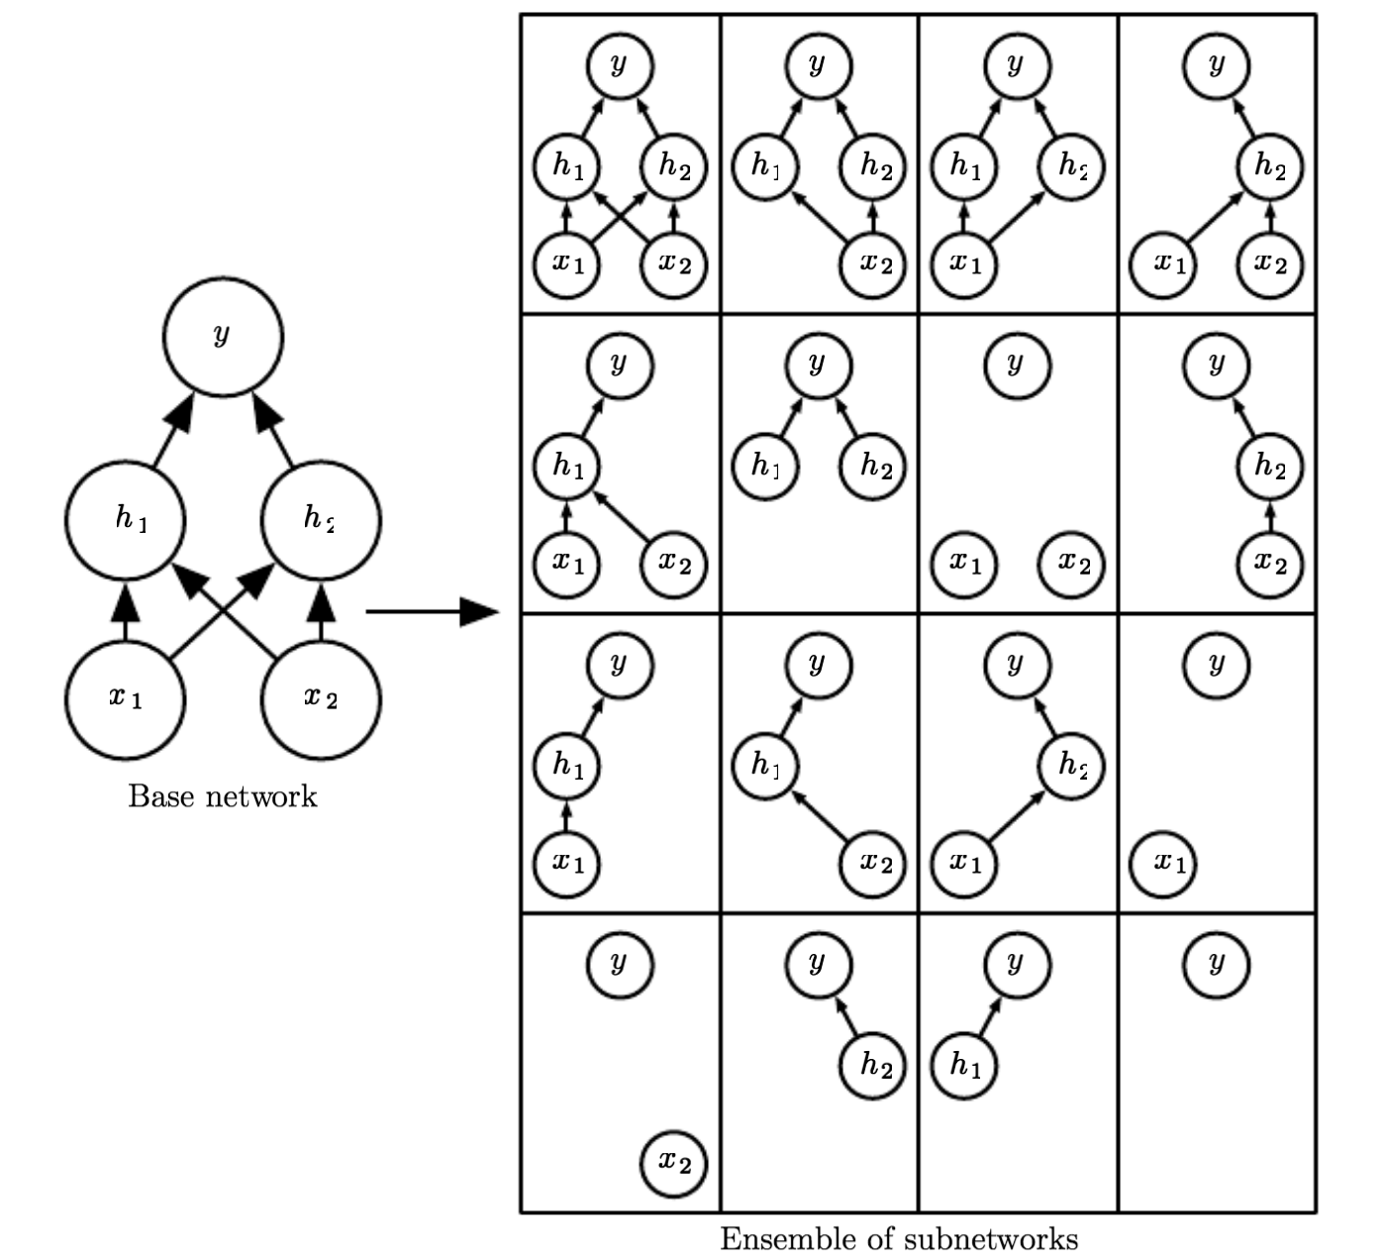
Dropout
One of the key insights of dropout is that training a network with stochastic behavior and making predictions by averaging over multiple stochastic decisions implements a form of bagging with parameter sharing.

Slide 30
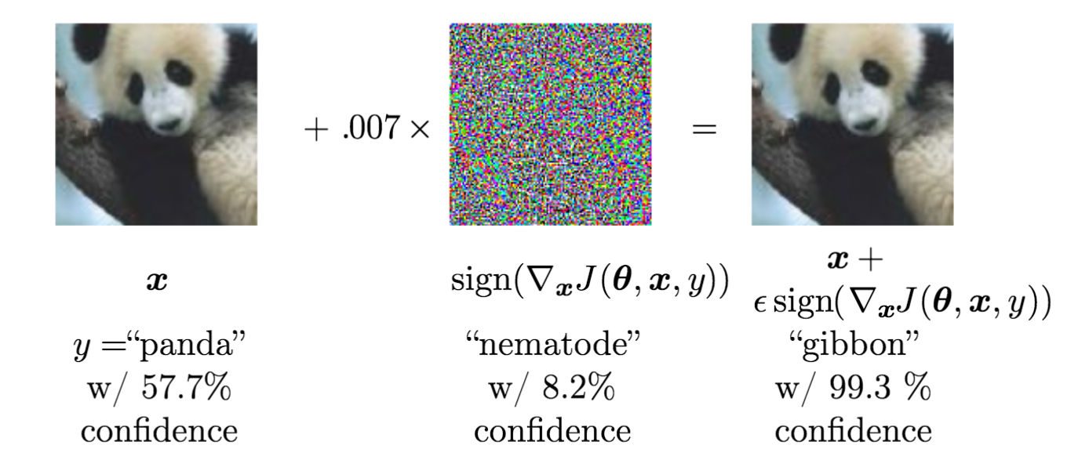
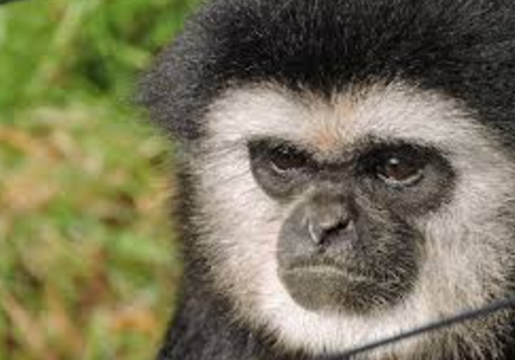
Adversarial Training
In many cases, neural networks have begun to reach human performance.
Examples that a human cannot tell the difference results in highly different predictions. These examples are called the adversarial examples.
Adversarial training is done via virtual adversarial examples.

